Slide 1
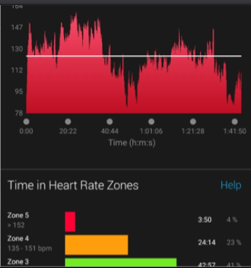
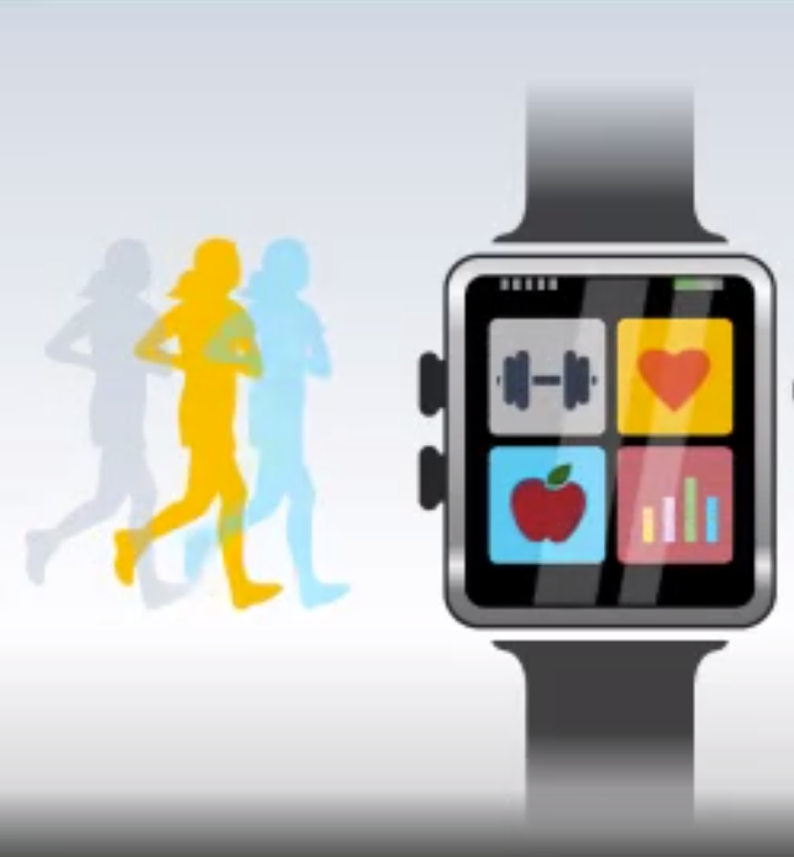
APPLE HEALTH DASHBOARD
Apple Health Dashboard
is a graphical tool to help medical professionals and patients interpret daily exercise activity data.
This software employs artificial intelligence to give relevant analysis of biometric data streams on a consistent basis. It automates data analysis, which was previously time-consuming and labor-intensive, and excels at extracting insights and patterns from large data sets.
https://github.com/Btheresi/KSU_Health_Dashboard
Bonnie Theresias

